Slide 1
Chapter 19-20
Redux

Slide 2
Objectives
Redux architecture
Actions
Reducer
Stores
Views

Slide 3
Redux architecture
Notes:
Session: Ghi số thứ tự session trong môn học
Session Name: ghi tên của session sẽ dạy

Slide 4
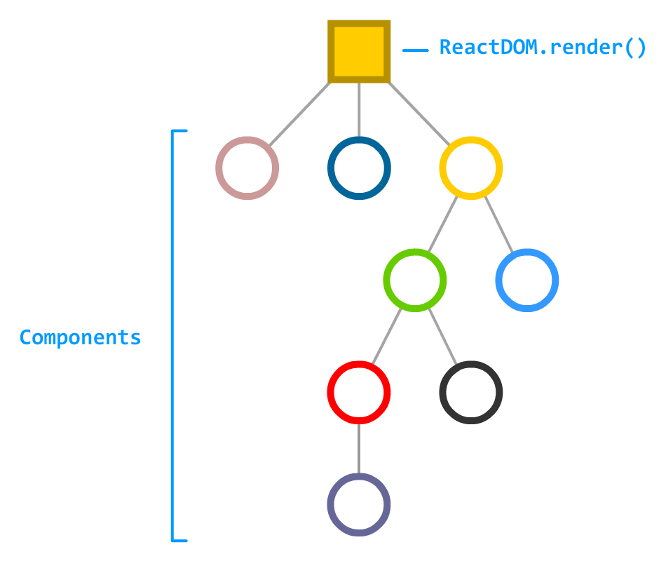
Now that you have a better idea of how Redux works, let's look at the topic we set out to better understand in the first place. Why is Redux so popular in React projects? To help answer this, take a look at the following component hierarchy for some arbitrary app

Slide 5
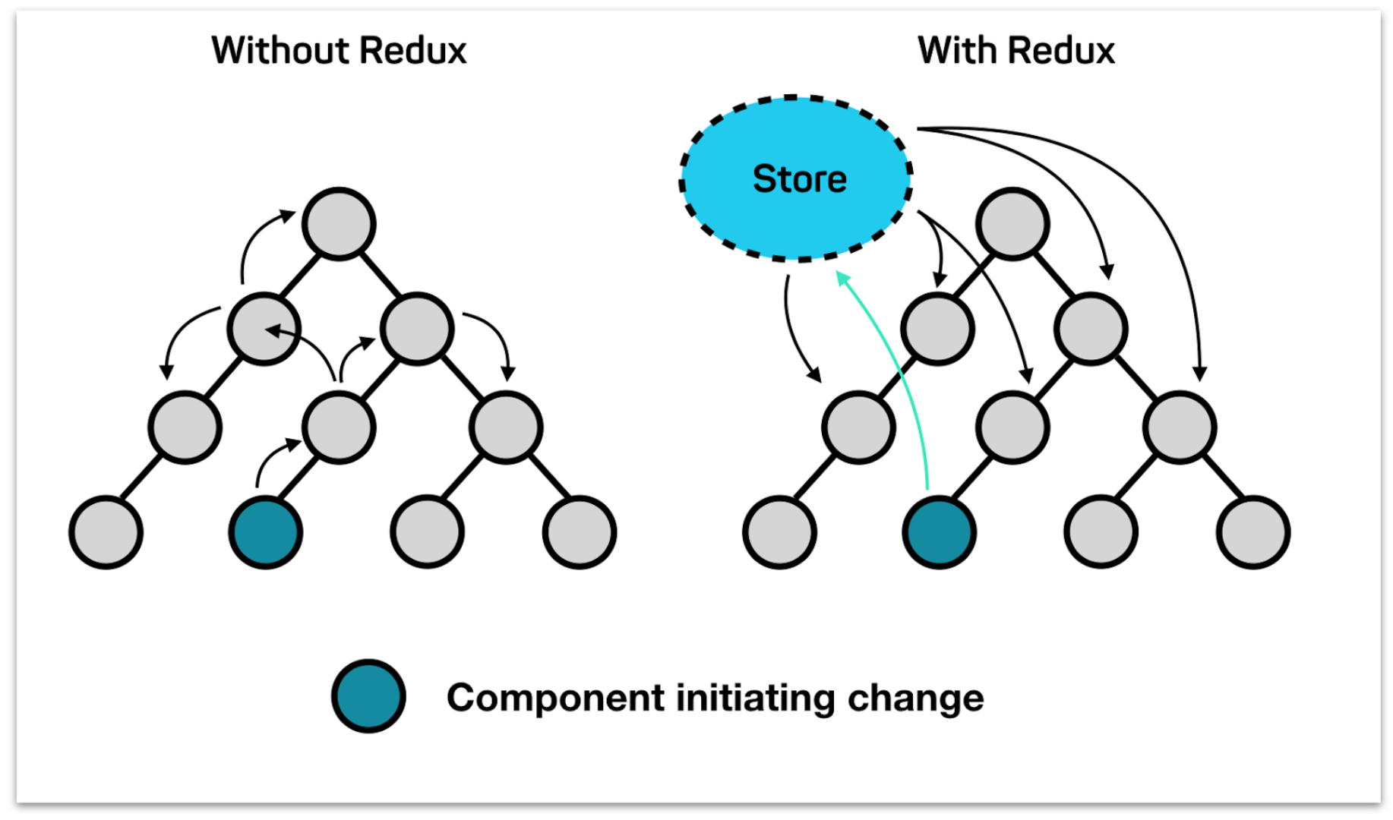
The problem

Slide 6

Redux Introduction
Redux is a predictable state container for JavaScript apps, and a very valuable tool for organizing application state. It’s a popular library to manage state in React apps, but it can be used just as well with Angular, Vue.js or just plain old vanilla JavaScript.

Slide 7
Redux Basics
Notes:
Session: Ghi số thứ tự session trong môn học
Session Name: ghi tên của session sẽ dạy

Slide 8
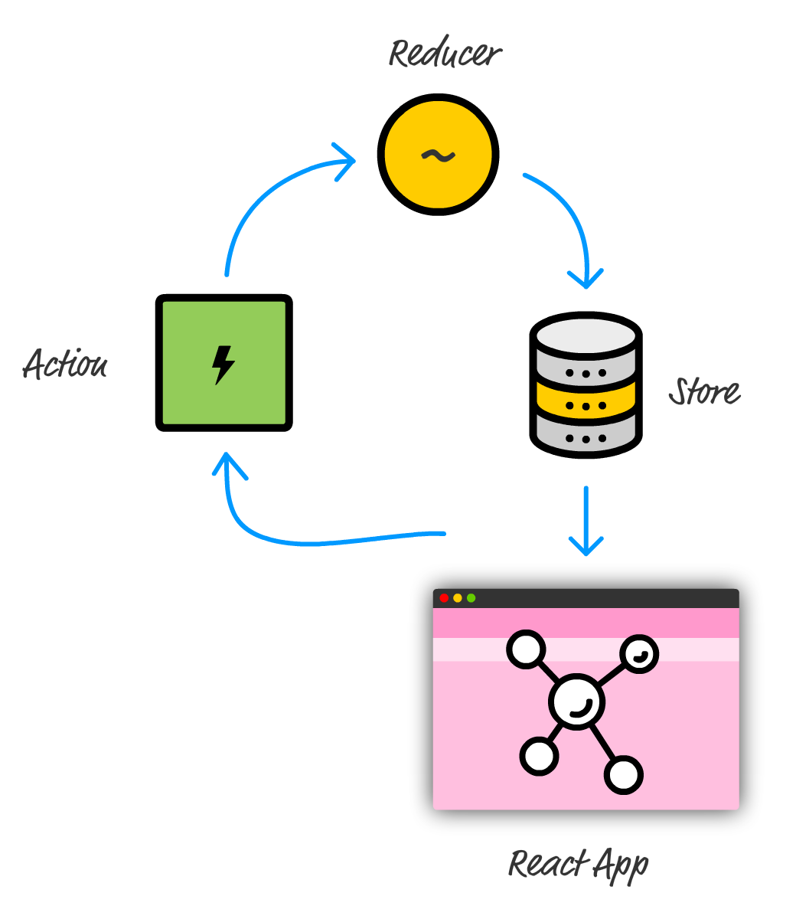
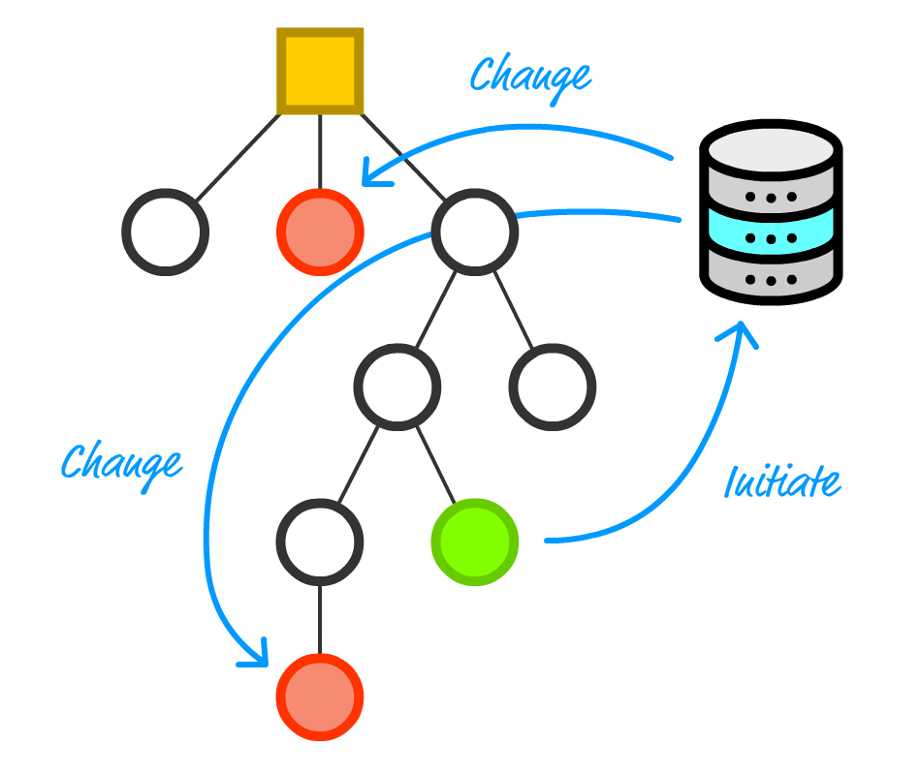
Redux structure
This approach solves several of our problems. If you want to share data from one part of your app with another, you can do that without having to navigate up and down your component hierarchy:

Slide 9
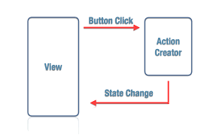
Actions
Actions are payloads of information that send data from your application to your store. They are the only source of information for the store
{
type: ADD_TODO,
text: 'Build my first Redux app'
}

Slide 10
Actions Creators
Action creators are exactly that—functions that create actions. It's easy to conflate the terms “action” and “action creator”, so do your best to use the proper term.
To actually initiate a dispatch, pass the result to the dispatch() function
The dispatch() function can be accessed directly from the store as store.dispatch(), but more likely you'll access it using a helper like react-redux's connect(). You can use bindActionCreators() to automatically bind many action creators to a dispatch() function.
function addTodo(text) { return { type: ADD_TODO, text } }
dispatch(addTodo(text)) dispatch(completeTodo(index))

Slide 11
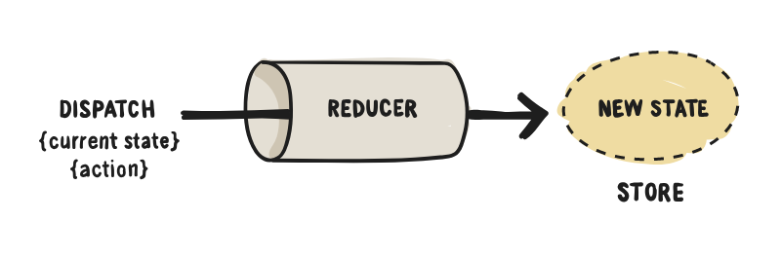
Reducers
Reducers specify how the application's state changes in response to actions sent to the store. Remember that actions only describe what happened, but don't describe how the application's state changes.
import { VisibilityFilters } from './actions' const initialState = { visibilityFilter: VisibilityFilters.SHOW_ALL, todos: [] } function todoApp(state, action) { if (typeof state === 'undefined') { return initialState } return state }

Slide 12
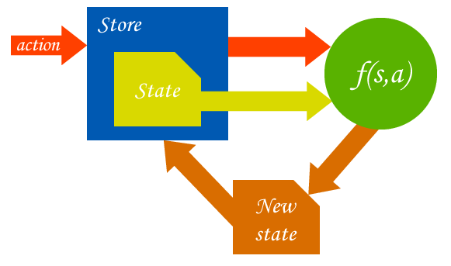
Store

Slide 13
Store
Create Store
Dispatching Actions
store.dispatch(addTodo('Learn about actions'))
import { createStore } from 'redux' import todoApp from './reducers' const store = createStore(todoApp, window.STATE_FROM_SERVER)

Slide 14
Usage with React
Installing React Redux
npm install --save react-redux
import React from 'react' import { render } from 'react-dom' import { Provider } from 'react-redux' import { createStore } from 'redux' import todoApp from './reducers' import App from './components/App' const store = createStore(todoApp) render( <Provider store={store}> <App /> </Provider>, document.getElementById('root') )

Slide 15
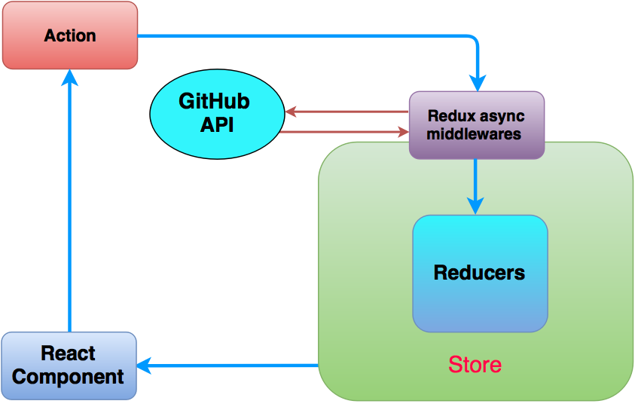
Usage with React

Slide 16
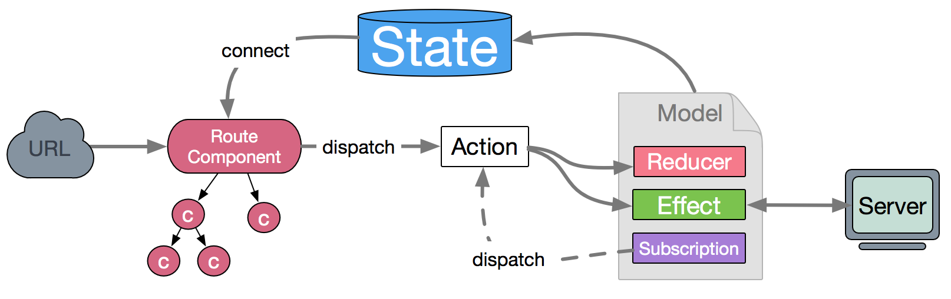
Anatomy of connect()
The connect() function provided by react-redux can take up to four arguments, all of which are optional. Calling the connect() function returns a higher-order component which can be used to wrap any React component.
connect([mapStateToProps], [mapDispatchToProps], [mergeProps], [options])

Slide 17
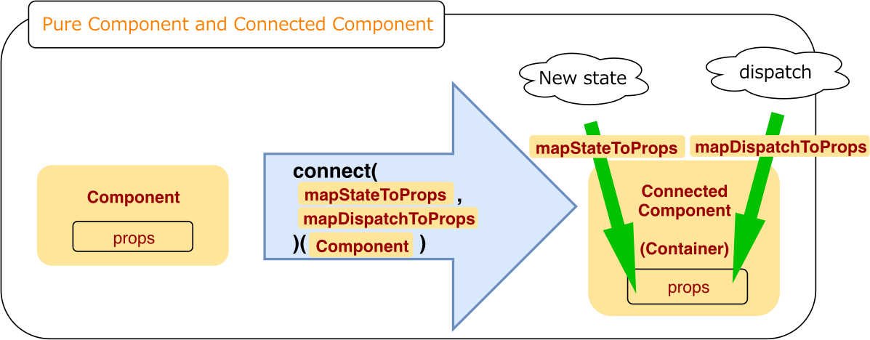
mapStateToProps(state, [ownProps]) => stateProps
function Passing this argument subscribes the container component to the Redux store updates, which means that the mapStateToProps function will be invoked each time the store updates. If you are not interested in store updates, leave it as undefined or null.

Slide 18
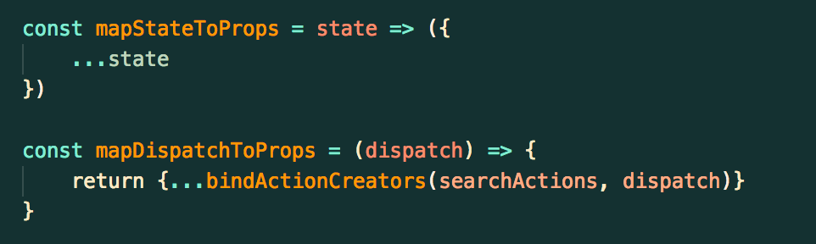
mapDispatchToProps(dispatch, [ownProps]) => dispatchProps
This argument can either be an object or a function that returns either a plain object or another function. To better illustrate how mapDispatchToProps works, you will need to have some action creators.
1. Default Implementation
2. Passing an object
3. Passing a function

Slide 19
Conclusion
In many ways, you could argue that Redux is designed to fix some of the shortcomings that React often claims as advantages. We looked at some of these advantages when we examined how data in React is supposed to flow.
You could even go further and say that the ideas behind Redux should be formalized as part of React itself so that you get even better integration.
The thing is this: Redux isn't perfect either. Like many things in programming, it is simply one of many tools you have for accomplishing a task. Not every situation involving data will need Redux. Sometimes, adding Redux can add unnecessary complexity to what you are trying to do.
Dan Abramov, one of the creators of Redux, wrote a great article explaining some of the situations when you probably shouldn't use Redux for solving your problem.

